Slide 1
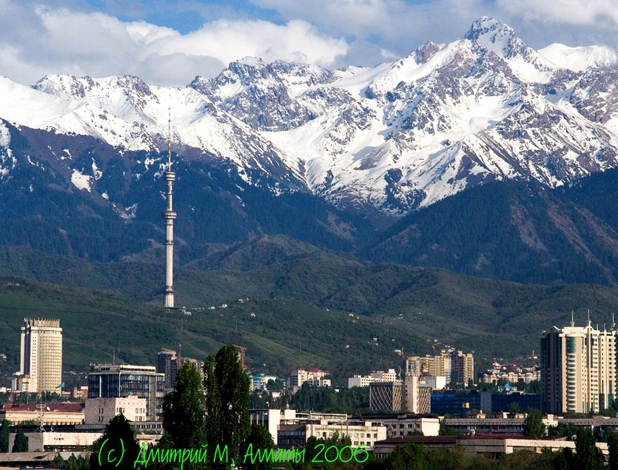
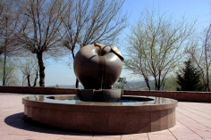
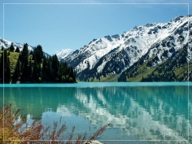
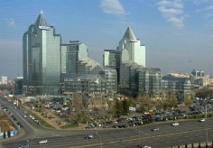
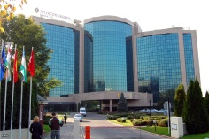

22 – 24 June 2011
Almaty, Kazakhstan

Slide 2
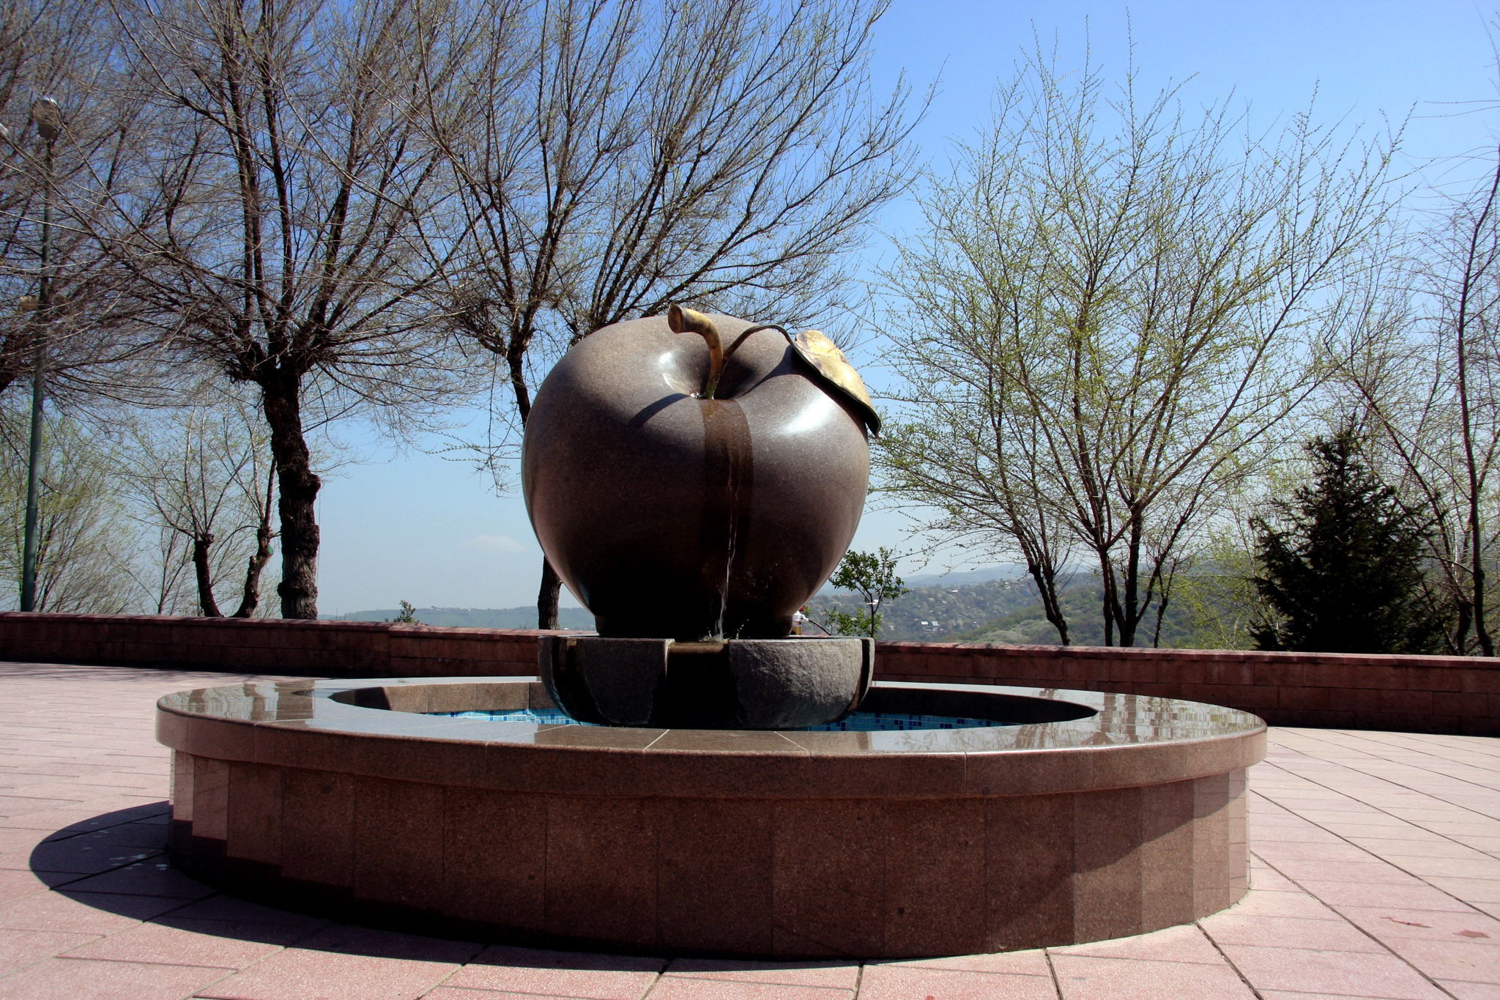
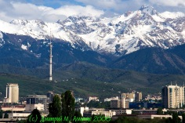
22 – 24 June 2011
Almaty, Kazakhstan

Slide 3


22 – 24 June 2011
Almaty, Kazakhstan

Slide 4
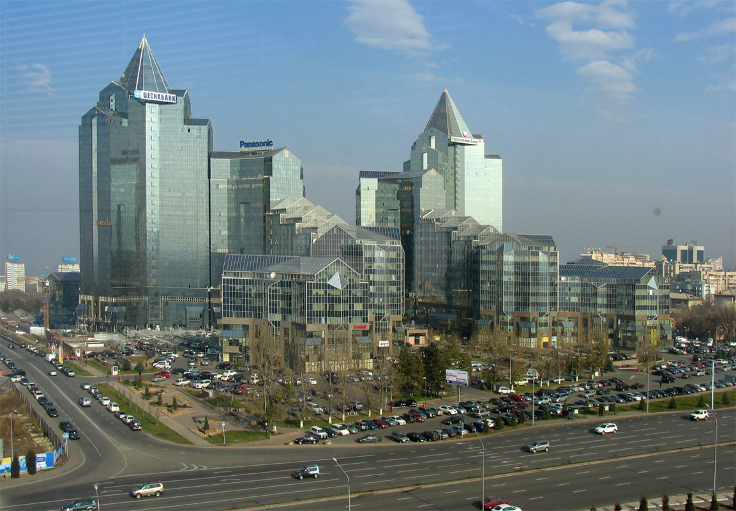

22 – 24 June 2011
Almaty, Kazakhstan

Slide 5
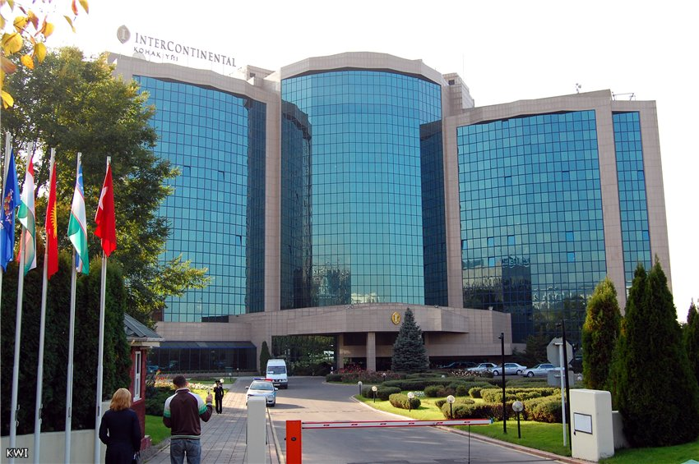
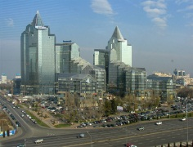
22 – 24 June 2011
Almaty, Kazakhstan

Slide 6
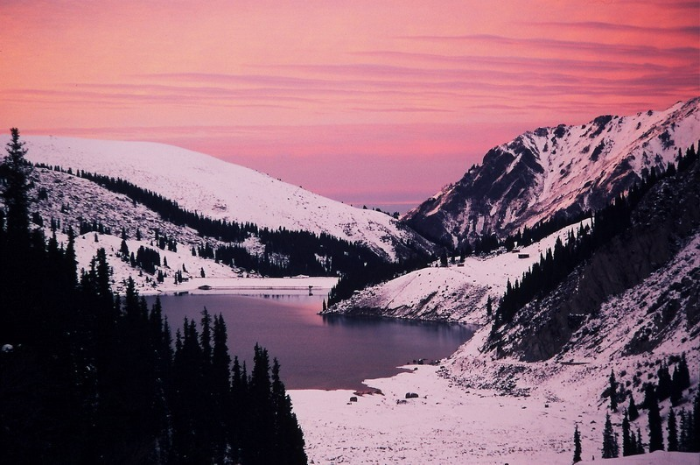
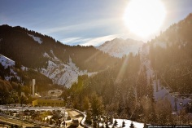


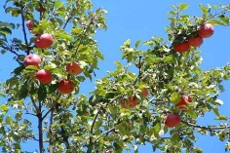
22 – 24 June 2011
Almaty, Kazakhstan

Slide 7
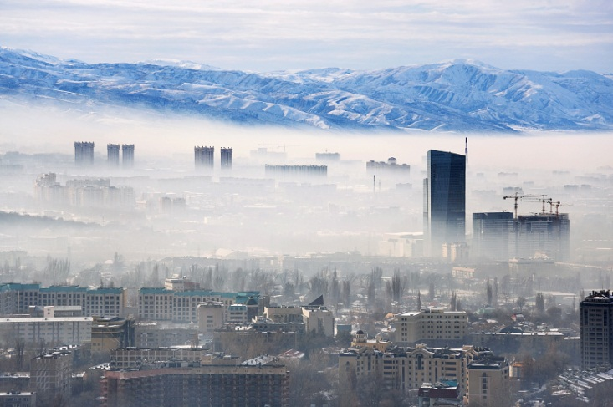
22 – 24 June 2011
Almaty, Kazakhstan

Slide 8
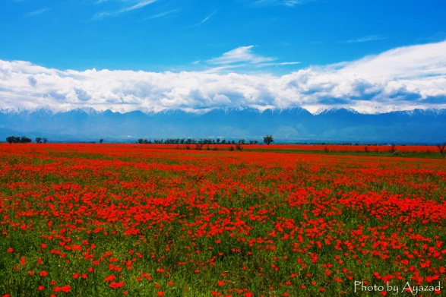
22 – 24 June 2011
Almaty, Kazakhstan

Slide 9
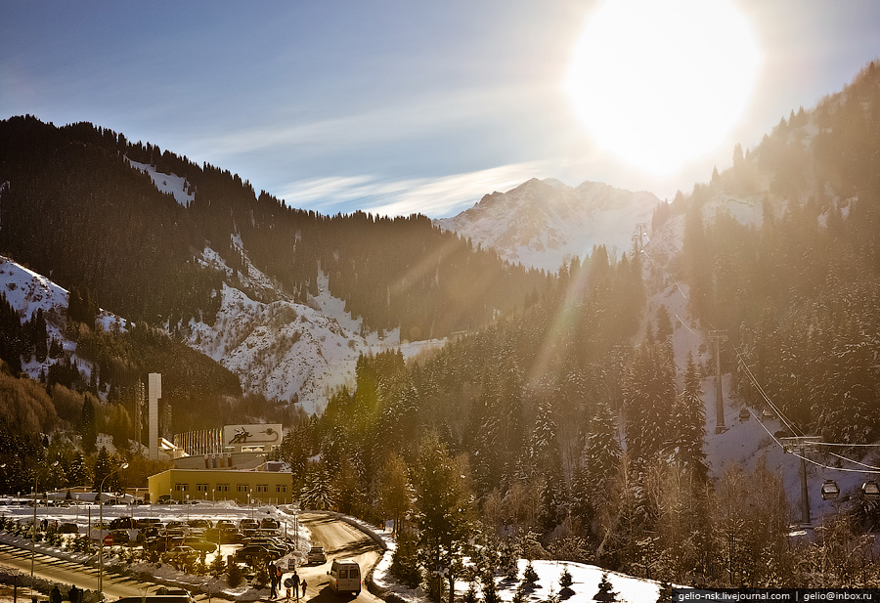
22 – 24 June 2011
Almaty, Kazakhstan

Slide 10
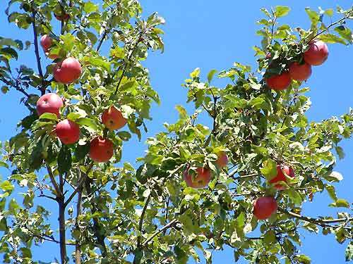
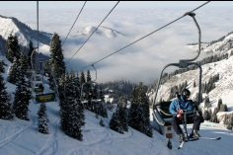
22 – 24 June 2011
Almaty, Kazakhstan

Slide 11
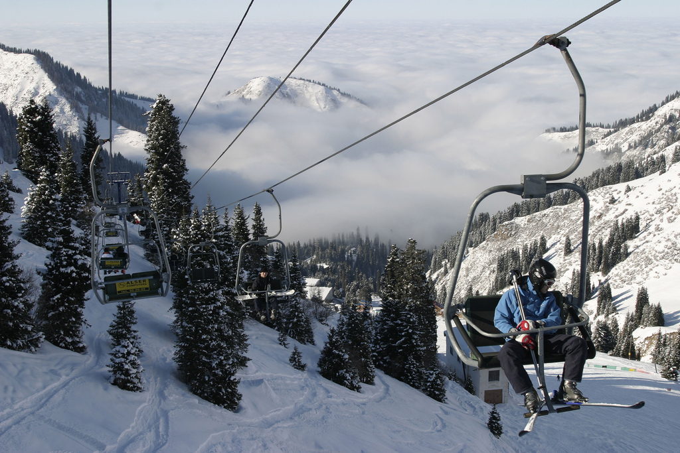
22 – 24 June 2011
Almaty, Kazakhstan

